Slide 1
Chapter 10: Molecular manufacturing
What is molecular manufacturing?

Slide 2
Definition and examples
Molecular manufacturing produces chemicals and structures that have a very specific shape or chemical composition.
This allows them to be designed for specific tasks or to have properties that can be chosen and designed to order.
Molecular manufacturing is already used to produce material, batteries and medicines.

Slide 3
Macro and nano properties
Nanotechnology is a key process used in molecular manufacturing where the manipulation of atoms and structures happens at the nano level.
A nanometer is one-billionth of a metre and most atoms and molecules are around this size.
Nanoparticles of a particular material have very different properties from the macro version of the same material.
Notes:
Figure C10.1 shows relative size and scale of common objects compared to nanomaterials.

Slide 4
Macro and nano properties
When a material is made nanosized, properties such as surface area, melting point, and the ability to reflect light and conductivity change.
Gold as a nanoparticle reflects light differently because of its hugely increased surface area, so appears as a range of colours dependent on its particle size.
Notes:
Figure C10.1 shows relative size and scale of common objects compared to nanomaterials.

Slide 5
Methods – the orientation effect
The orientation of particles during a reaction affects how they react.
Molecules with multiple functional groups can form various products, many of which are undesired.
Orienting molecules correctly can give a targeted product with a high yield and few, if any, unwanted products.
Also called mechanosynthesis.

Slide 6
Methods – atomic structure and bonding
Bonding between atoms, ions and molecules can be controlled so that particular products form.
Changing the bonding in a structure alters the properties of the chemical. With proper control, a product with specific properties can be produced.
Adding atoms in a specific arrangement can also create structures with particular shapes that can act as containers or scaffolds.

Slide 7
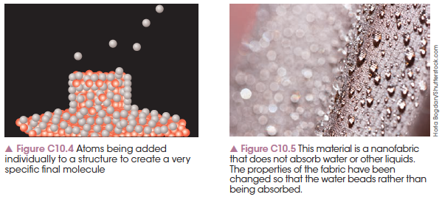
Methods – atomic structure and bonding

Slide 8
Methods – protecting groups
When an organic molecule has multiple functional groups, the addition of two molecules can have multiple outcomes.
If a specific group is not supposed to react, then it can be temporarily protected through a chemical reaction.
The reaction is reversed after the final molecule is produced and ‘unprotected’.

Slide 9
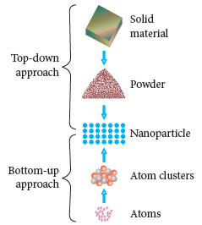
Top-down method
A top-down approach starts with a large amount of a solid material that is broken down into smaller pieces until nanoparticles are achieved.

Slide 10
Bottom-up method
A bottom-up approach starts with individual atoms and builds a structure through atomic addition.
This is usually used when the final product needs to have a specific structure.

Slide 11
Chapter 10: Molecular manufacturing
Orientation effect

Slide 12
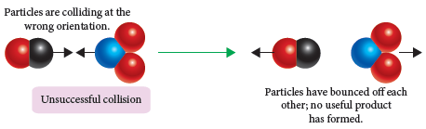
Reaction sites
When particles collide, a reaction will occur if the correct functional groups or parts of the molecule are in contact.

Slide 13
Reaction sites
Mechanosynthesis involves bringing together molecules in a particular orientation so that the correct parts of the molecules are in contact to react.
The more of the correct functional groups that make contact, the more product is made and fewer unwanted side reactions occur. There is also a faster rate of reaction.

Slide 14
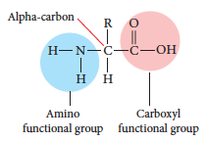
Protein synthesis
Proteins are formed when amino acids join, but this requires the amine group of one acid to join with the carboxylic acid of a different amino acid. The Zwitterion ion contains both the + and – ion.

Slide 15
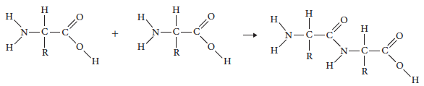
Protein synthesis
When the correct groups line up, two amino acids will form a dipeptide. If the two amine groups line up, no structure will form.
These long chain amino acids can be shown by their abbreviated first three letters, e.g.
-Cys-Val-Phe-Glu-Ala-Trp-Gln- etc
Notes:
Activity 10.1 Modelling Dipeptides

Slide 16
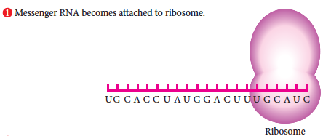
Ribosomes
Proteins are naturally lined up by structures called ribosomes. Ribosomes are natural molecular machines that apply the orientation effect.

Slide 17
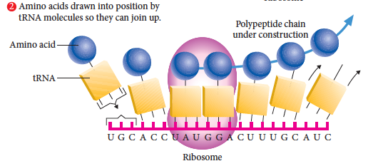
Ribosomes
A ribosome naturally ensures the amine and acid group line up so a polypeptide chain forms correctly.

Slide 18
Protein folding
Hydrogen bonding between primary polypeptide chains or within a chain causes formation of alpha helix or beta-pleated sheet secondary structures.
Tertiary structures form when the R groups on the amino acids bond through ionic, covalent and secondary intermolecular forces.
Multiple tertiary structures can bond together to form a quaternary structure.

Slide 19
Artificial protein synthesis
Artificial protein synthesis in a laboratory utilises the orientation effect by using a solid resin in a process called Solid Phase Peptide Synthesis.
The amino acids attach to the resin in a particular orientation, ensuring the amine and acid groups line up and a polypeptide chain forms.
The resin takes the place of the ribosome in natural protein synthesis.

Slide 20
Chirality
Artificial protein synthesis allows for the formation of new amino acids or stereoisomers. A stereoisomer is a mirror image of the original amino acid and has different properties.
Notes:
Activity 10.2 Modelling Chiral Molecules.

Slide 21
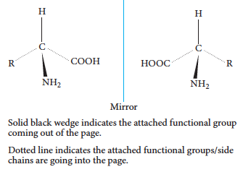
Chirality

Slide 22
Chapter 10: Molecular manufacturing
DNA nanotechnology

Slide 23
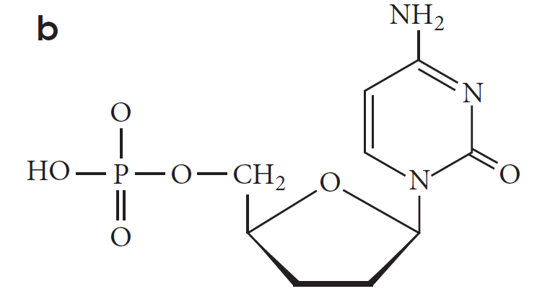
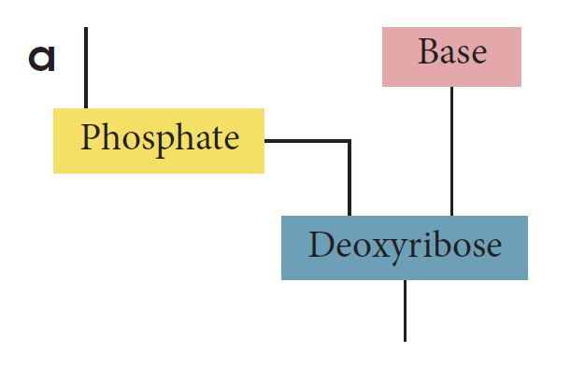
DNA structure
DNA, or deoxyribonucleic acid, has an ordered structure with a series of nucleotides consisting of a sugar, phosphate group and a nitrogenous base.

Slide 24
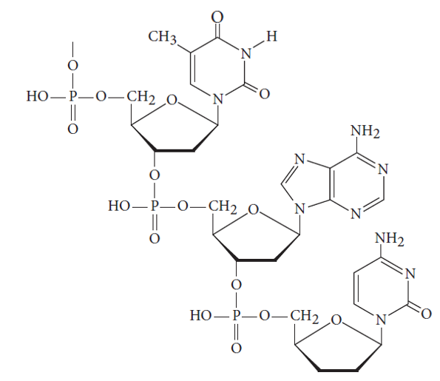
DNA structure

Slide 25
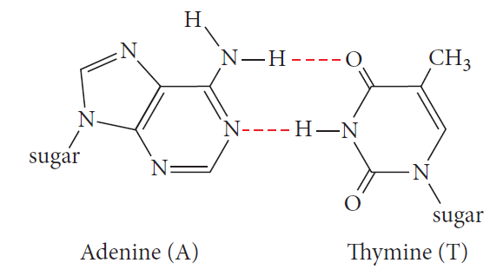
The double helix
The double helix of DNA is held in shape by hydrogen bonds that form between the nitrogenous bases.

Slide 26
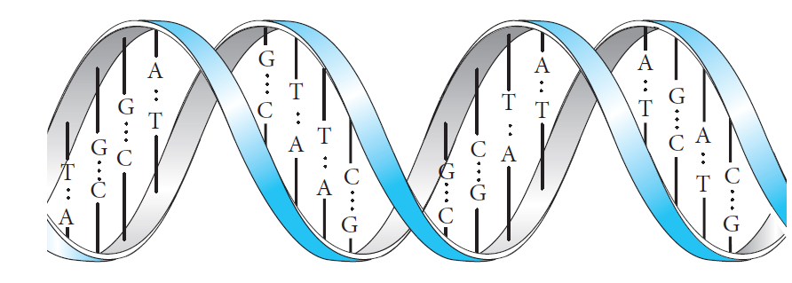
The double helix

Slide 27
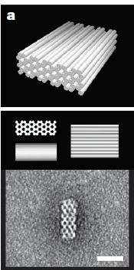
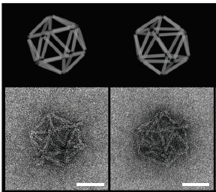
Artificial nucleic acids
Using the ordered structure of DNA, a structure can be synthesised with a specific shape, creating containers, ladders, rings and scaffolds.

Slide 28
Artificial nucleic acids
The base pairing of DNA can be used to ‘grow’ a structure.
A template is created by making a specific series of bases, so that when the new DNA strand grows and pairs with the existing chain, it grows in a particular pattern.
The original base sequence is designed so that when the pairings occur a desired shape will form.

Slide 29
DNA machines
DNA machines, such as molecular robots, are being developed to perform tasks on the nano scale.
A molecular robot can recognise a molecule such as a virus or bacteria. It can also carry chemicals such as medicines to a particular site in the body.
These machines can perform these tasks automatically and are built on the nano scale using artificial DNA synthesis.

Slide 30
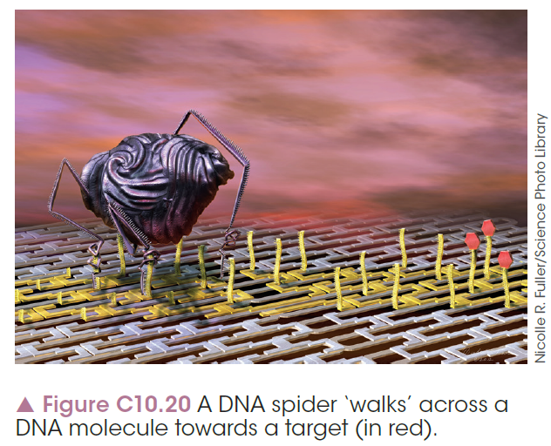
DNA machines

Slide 31
Chapter 10: Molecular manufacturing
Bonding and atomic manipulation

Slide 32
Introduction
The bottom-up approach to nanotechnology is to build up a structure by adding atoms individually to create the desired structure or chemical.
Nanomaterials with a specific structure have properties that are desirable, such as low density, increased conductivity or microbial resistance.

Slide 33
Supramolecular chemistry
Supramolecular chemistry works with the bonding that occurs between atoms and molecules.
If you control the bonding that occurs between molecules, you can form specific structures. In some cases, these molecules can form themselves from reactant atoms.
Molecules will bond to other specific molecules when they will form the same bonds. This can be controlled by making the molecule with atoms in a specific arrangement.

Slide 34
Self-assembly
Molecular self-assembly occurs when molecules in a random arrangement form an ordered pattern due to the formation of secondary interactions between molecules.
The secondary interactions form because specific functional groups are present in a particular site on the molecule.
When the functional groups line up, the whole material becomes more ordered and the properties change.

Slide 35
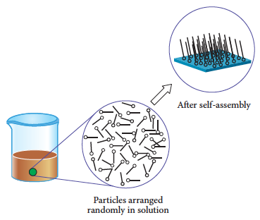
Self-assembly
An external stimulus, such as electricity or heat, is applied, causing the particles to arrange themselves.

Slide 36
Molecular recognition
Molecular recognition involves bonding through secondary interactions.
Molecules are designed with functional groups in locations that will allow two molecules to bond to each other.
One molecule is a host and contains sites to bond to a guest molecule.

Slide 37
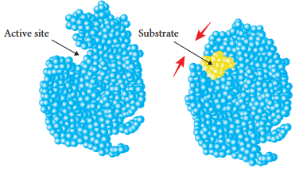

Molecular recognition
An example of a host–guest complex is an enzyme. The enzyme bonds to a specific molecule, such as glucose or a fat molecule. Each enzyme has sites to bond to molecules with different functional groups.

Slide 38
Nanotubes
Nanotubes are extremely small tubes artificially constructed from carbon, silicon, DNA or other materials.
Carbon nanotubes are formed from sheets of graphene and can be single- or double-walled sheets.
Nanotubes are extremely strong and highly conductive so have a number of applications in batteries, fuel cells and structural materials.

Slide 39
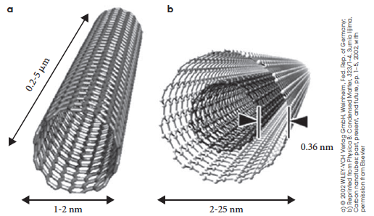
Nanotubes

Slide 40
Nanoparticles
Nanoparticles are particles in the nano range, between 1 and 10,000 nm in diameter.
They can be made by adding individual atoms together in a bottom-up approach or by breaking down larger samples in a top-down approach.
Nanoparticles are used to make highly uniform material because their small size enables them to pack tightly.

Slide 41
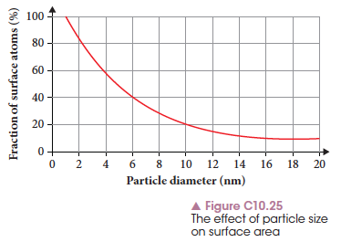
Nanoparticles
They also are effective as catalysts because they have a large surface area so can increase reaction rate by large amounts.

Slide 42
Chapter 10: Molecular manufacturing
Protecting groups

Slide 43
Introduction
Chemoselectivity is the production of a specific molecule or chemical when a range is possible.
When organic molecules have multiple functional groups, it is hard to control which one reacts.
A protecting group can be temporarily added to a molecule to prevent a particular functional group from reacting. This allows the desired groups to react and form the target product.

Slide 44
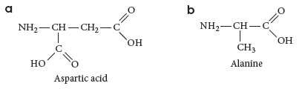
Dipeptides
Many amino acids have functional groups in addition to the amine and carboxylic acid. The R groups can also have hydroxyl groups or extra amine and acid groups.
When two amino acids react, there are multiple possible products.

Slide 45
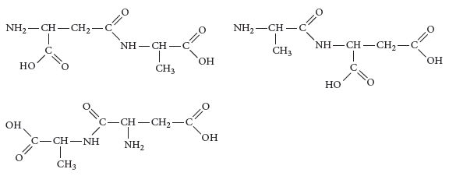
Dipeptides
The presence of two carboxylic acid groups means three possible products with different properties.

Slide 46
Unwanted side reactions
Unwanted products can form in reactions that can contaminate the final product, reduce its purity, or decrease its effectiveness.
Acids added as catalysts often cause functional groups to react and form ions, which cause further reactions.
Protecting groups can prevent parts of a molecule from reacting and prevent unwanted chemicals forming.

Slide 47
Examples
Organic groups such as the hydroxyl, amine and carboxylic acids can be converted to other, less reactive functional groups like amides and esters.
These are simple esterification and condensation reactions that are easily reversed at the end of the process.

Slide 48
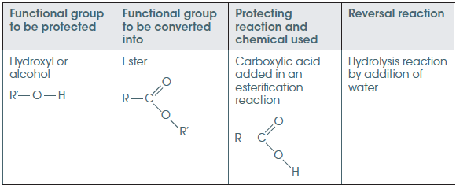
Alcohol and carboxylic acid protection
Alcohols and carboxylic acids undergo esterification reactions when protected.

Slide 49

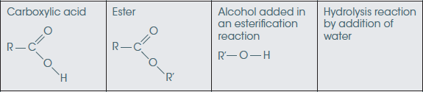

Alcohol and carboxylic acid protection
An ester forms by:

Slide 50

Alcohol and carboxylic acid protection
To reverse the reaction and unprotect the group, a hydrolysis reaction occurs:

Slide 51
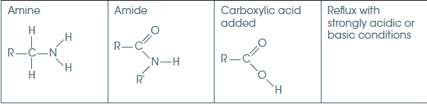
Amine protection
An anime is protected by reaction with a carboxylic acid to form an amide.

Slide 52


Amine protection
The protection reaction:
The reaction is reversed by:

